Slide 1
Advanced C++
Chapter 11 - Operator Overloading – Part 1
Fall 2011
Kristina Shroyer

Slide 2
Chapter Objectives
What operator overloading is and how it makes programs more readable and programming more convenient.
To redefine (overload) operators to work with objects of user-defined classes.
The differences between overloading unary and binary operators.
To convert objects from one class to another class.
When to, and when not to, overload operators.
To see some examples of classes that demonstrate operator overloading
To use overloaded operators and other member functions of standard library class string.

Slide 3
Introduction to Operator Overloading
We've been sending messages between instances of our classes using the dot operator
  This can become cumbersome for certain operations in certain kinds of classes (ones with mathematical operations for example)
  Sometimes it would be easier and more clear if we could use operators to perform some of the methods/operations on the data members of our class data types
Operator Overloading is a technique that allows us to use the operators in C++ (+, -, *, ++ etc) to work with our classes (and instances of our classes)
  So instead of just overloading functions (mainly we've done this with constructors) now we're going to overload C++ operators to perform operations on our objects
    We've already been doing this in our programs the difference is now we will learn to program it in our own classes:
      So + will work one way with strings, one way with integers, etc….and another way with our objects based on how we define it

Slide 4
Introduction to Operator Overloading
We've been using operator overloading implicitly since we first began programming
Examples
  <<
    Stream insertion, bitwise left-shift
  +
    Performs arithmetic on multiple items (integers, floats, etc.), when used with strings concatenates them, performs differently when used with pointers
    So the + behaves differently depending on what its operands are, we can also define how the + should behave on instances of our data types
Anything we do using operator overloading can also be done with regular member functions using explicit function calls
  However, the operator notation is often easier for programmers and remember the goal of readability
So we will learn to use operators with objects (operator overloading)
  Clearer than function calls for certain operations in classes
  Operator sensitive to context
There are certain situations where it's appropriate to overload operators and certain situations where it is not appropriate, we'll learn both

Slide 5
Fundamentals of Operator Overloading
Programmers can use operators with user defined data types (operator overloading)
  New operators can NOT be created
  But existing operators can be overloaded so that when these operators are used with objects they have meaning appropriate to those objects
    Similar to how + means one thing when used on strings and other thing when used on numeric types
How to overload operators
  First write a NON-STATIC member function definition or a global function definition as you normally would EXCEPT:
    the function name will now start with the keyword operator, the word operator will be followed by the symbol for the operator being overloaded
    Example
      operator+
  When operators are overloaded as member functions they must be non-static
    This is because they must be called on an object (instance) of the class and must operate on that object

Slide 6
Fundamentals of Operator Overloading
To use an operator on a class object (instance), it must be overloaded for that class
  THREE Exceptions: (these can also optionally be overloaded by the programmer)
    Assignment operator (=)
      Memberwise assignment between objects (this is how it works if NOT overloaded)
      As we've seen this operator (or anything involving memberwise assignment such as the copy constructor) doesn't work well with pointers and should be overloaded in these type of cases
    Address operator (&)
      Returns address of object
      Can be overloaded by the programmer
    Comma operator (,)
      Evaluates expression to its left then the expression to its right
      Returns the value of the expression to its right
      Can be overloaded by the programmer
Overloading provides more concise notation than not overloading in many cases
  object2 = object1.add( object2 );
  vs.
  object2 = object2 + object1;

Slide 7
Fundamentals of Operator Overloading
Programming Observations and Tips
  Operator overloading contributes to C++’s extensibility
  Use operator overloading when it makes a program clearer than accomplishing the same operations with function calls
  Overloaded operators should mimic the functionality of their built-in counterparts
    Example: the + operator should be overloaded to perform addition, not subtraction
    Avoid excessive or inconsistent use of operator overloading, as this can make a program cryptic and difficult to read.

Slide 8
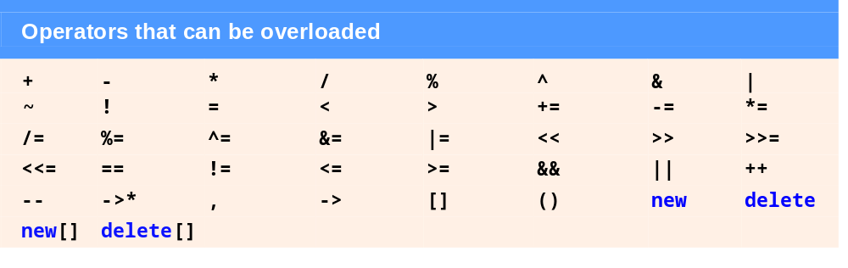
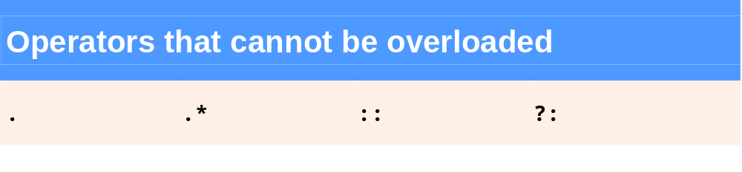
Restrictions on Operator Overloading
Most of C++'s operators can be overloaded but there are some which cannot
  The operators that can and can not be overloaded are shown below

Slide 9
Restrictions on Operator Overloading
Certain things cannot be changed by operator overloading
Operator Overloading Can NOT change the following:
  Precedence of operator (order of evaluation)
    Use parentheses to force order of operators
  Associativity (left-to-right or right-to-left)
  Number of operands (this is called the arity of an operator)
    e.g., & is unary, can only act on one operand
    C++ has one ternary operator ?: which cannot be overloaded
  How operators act on built-in (fundamental) data types (i.e., cannot change integer addition)
    Operator overloading only works with objects of user defined types or with a mixture of an object of a user defined type and an object of a fundamental (primitive/built in) type
    So operator overloading will never work with only fundamental types

Slide 10
Restrictions on Operator Overloading
No new operators allowed (ie cannot create new operators)
  Only existing operators can be overloaded
  Unfortunately this prevents using notations like ** for exponentiation
    you could overload an existing operator for exponentiation though
Operators must be overloaded explicitly
  Overloading + and = does not overload +=
  So overloading
    object1 + object2
    does NOT imply the following is overloaded
      object1 += object2 (would need EXPLICITY overloaded)

Slide 11
Restrictions on Operator Overloading
Common Programming Errors/Restriction Summary
  Attempting to overload a non-overloadable operator is a syntax error
  Attempting to change the arity (how many operands it takes) of an operator via operator overloading is a compilation error
  Attempting to create new operators via operator overloading is a syntax error (like **)
  At least one argument of an operator function must be an object or reference of a user-defined type
    This prevents programmers from changing how operators work on fundamental types
    Attempting to modify how an operator works with objects of fundamental types is a compilation error
  Assuming that overloading an operator such as + overloads related operators such as += or that overloading == overloads a related operator like != can lead to errors
    Operators can be overloaded only explicitly; there is no implicit overloading

Slide 12
Operator Functions as Class Members vs. Global Members
Operator functions (operator overloading functions) can be:
  member functions
    Use the this pointer implicitly to obtain one of their class object arguments (the left operand for binary operators)
      Remember one of the operands must be an object, can't override an operator on two primitive (fundamental) types
  global functions
    global functions are often made friends for performance reasons
      This also gives them direct access to private or protected member data
    arguments for both operands must be explicitly listed
Certain operators MUST be overloaded as member functions
  Operators (), [], -> or any assignment operator (=) must be overloaded as a class member function
There are also certain operators that MUST be overloaded as global members which we'll see in a bit
The other overloadable operators may be overloaded as member functions or global functions

Slide 13
Operator Functions as Class Members vs. Global Members
Should the operator be overloaded as a global function or a member function?
  In the cases where there is a choice an operator is still used in the same way in expressions whether it is overloaded as a global function or a member function, so which should be used?
When an operator function is overloaded as a member function:
  the leftmost (or only in the case of unary) operand must be an object (or reference to an object) of the operator's class
    Meaning the left operand of the + for example would have to be an object (or reference to) of the class the operator is overloaded in
      So if you are overloading the + operator in a Rectangle class the operand on the left side of the + must be a Rectangle instance in order to be overloaded as a member function
  This means operator functions overloaded as member functions are implicitly called when
      Left operand of binary operator is of this class
      Single operand of unary operator is of this class
When an operator function MUST be overloaded as a global function
    If the leftmost (or only) operand must be a fundamental type or an object of a different class this operator must be overloaded as a global function (so it can't be overloaded as a member function in this case)
      We'll see that a global overloaded operator function can be made a friend if it needs to access private or protected members of the class directly
In general I would say only overload an operator as a global function if it can't be overloaded as a member function for the reason explained above

Slide 14
Operator Functions as Class Members vs. Global Members
The stream insertion (<<) and stream extraction (>>) operators must be overloaded as global functions
This is because the << operator is typically used in a way in which
  The left operand is of type ostream &
    Such as cout object in cout << classObject
Similarly the >> operator is typically used in a way in which
  The left operand is of type istream &
    Such as cin object in cin >> classObject
Remember overloaded operators should mimic the functionality of their built-in counterparts
  We don’t want to make them confusing for the programmer
This means the << and >> operators can NOT be overloaded as member functions since the left operands are not objects of the same type as the class the overloaded operator function is defined in
Since each of these overloaded operator functions may/most likely will require access to the private members of the object being output or input, these overloaded functions can be (and often are) made friend functions

Slide 15
Operator Functions as Class Members vs. Global Members
Performance Tip with operator functions overloaded as global functions (like << and >>)
  It is possible to overload an operator as a global, non-friend function but:
    such a function requiring access to a class’s private or protected data would need to use set or get functions provided in that class’s public interface
    The overhead of calling these functions could cause poor performance, so these functions can be inlined to improve performance (however that violates data hiding)
    Alternatively the function can be made a friend to avoid this performance issue
      This is the best way to do it in my opinion

Slide 16
Operator Functions as Class Members vs. Global Members
Commutative operators
  These are a another reason you may want/need to make an operator overloading function a global function instead of a member function
Example:
  May want + to be commutative for the HugeInt class
    So both “a + b” and “b + a” work
    Overloaded operator can only be member function when its class is on left
      HugeInt + long int
        Can be member function
    When other way, need a global overloaded function
      long int + HugeInt
        Cannot be a member function , must be global
So we have TWO reasons we may have to make our overloaded functions global rather than member functions
  The right side of the operator needs to be something other than an instance of the class the operator is being overloaded in
  commutative operators can cause #1 to happen as well

Slide 17
Overloading Stream Insertion and Stream Extraction Operators
C++ can input and output fundamental types using the << and >> operators
The class libraries provided with C++ overload the << and >> operators for each fundamental type to process each type correctly including pointers and C-Style strings
You can overload these operators to perform input and output for user-defined types
Example 1
  Class PhoneNumber
    Holds a telephone number
  Print out formatted number automatically
    (123) 456-7890

Slide 18
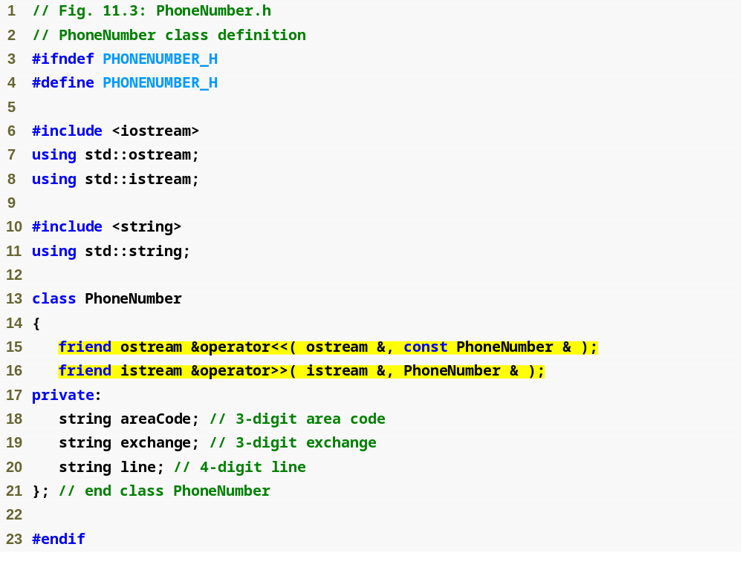
EXAMPLE 1
PhoneNumber.h
(1 of 1)
Review Question:
Why is the second argument
of the << function const?
Notice function prototypes for overloaded operators >> and << (must be global, friend functions)
Why do the functions return ostream& and istream& ?
Question: Why is this?

Slide 19
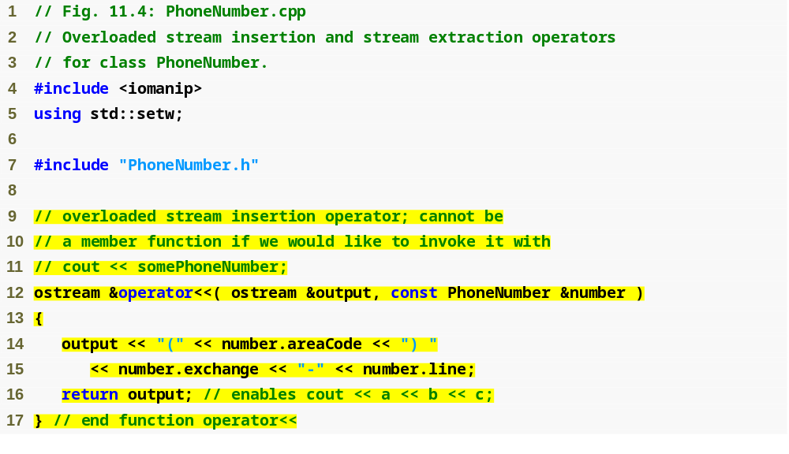
Allows cout << phone; to be interpreted as: operator<<(cout, phone);
EXAMPLE 1
PhoneNumber.cpp
(1 of 2)
Display formatted phone number
The stream insertion operator function for operator << takes ostream reference output and a const PhoneNumber reference number as arguments and
returns an ostream reference
Function operator << is used to display objects of type PhoneNumber
When the compiler sees a call like this:
  cout << phone; (assuming phone is an object of type phone number
  it generates the global function call: operator<<(cout, phone);

Slide 20
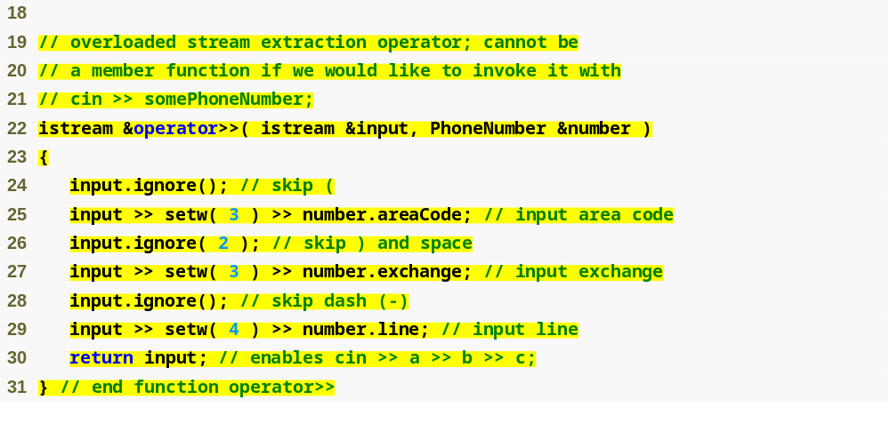
ignore skips specified number of characters from input (1 by default)
EXAMPLE 1
PhoneNumber.cpp
(2 of 2)
Input each portion of phone number separately
The parenthesis, dash and spaces are skipped by calling the istream member function ignore, which discards the specified number of characters in the input stream (one by default)
When used with cin and strings, setw restricts the number of characters read in in the next stream to the number specified by its argument
The function returns a reference variable input &input (ie cin).
  This enables input operations on phone number objects to be cascaded with input operations on other Phone number objects or on objects of other data types
    Like: cin >>phone1 >> phone2;
    or cin >> phone1 >> name; //name is a string

Slide 21
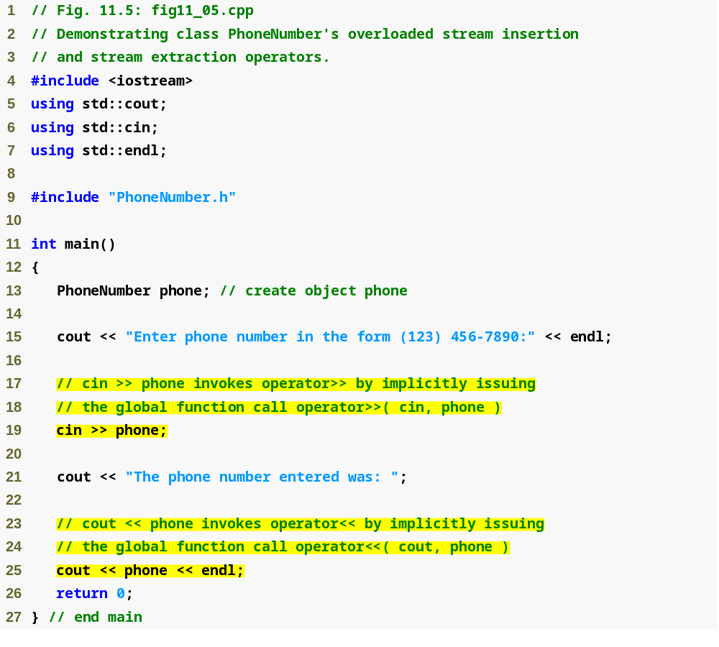
EXAMPLE 1
testPhone.cpp
(1 of 1)
Testing overloaded >> and << operators to input and output a PhoneNumber object

Slide 22
Software Engineering Observation
New input/output capabilities for user-defined types are added to C++ without modifying C++’s standard input/output library classes
  This is another example of C++’s extensibility

Slide 23
Overloading Unary Operators
Overloading unary operators
  Can overload as non-static member functions with no arguments
    So the unary just acts on an instance of the class
    Remember, static functions only access static data
      Overloaded member functions need to access the non-static members of the class
  OR Can overload as global function with one argument
    Argument must be class object or reference to class object

Slide 24
Overloading Unary Operators
Upcoming example (we're going to overload the ! operator to test whether or not an object of the string class we create is empty or not)
  Overload ! to test for empty string
  If implemented as a non-static member function, needs no arguments
    class String
    {
    public:
    bool operator!() const;
    …
    };
    when the complier sees !s it generates the function call s.operator!()
  If implemented as a global function , needs one argument
    bool operator!( const String & )
    when the complier sees !s it generates the function call operator!(s)

Slide 25
Overloading Binary Operators
Overloading binary operators
  For a non-static member function, one argument
  For a global function, two arguments
    One argument must be class object or reference

Slide 26
Overloading Binary Operators
Upcoming example: Overloading += on the string class
  If using a non-static member function, needs one argument
    class String
    {
    public:
    const String & operator+=( const String & );
    …
    };
    when the complier sees y += z it generates the function call y.operator+=( z )
  If using global function, needs two arguments
    const String &operator+=( String &, const String & );
    when the complier sees y += z it generates the function call
    operator+=( y, z )

Slide 27
Case Study: Array Class
C++ pointer based arrays (remember in C++ an array name is a pointer to the starting address of the array) have a number of issues:
  No range checking
  Cannot be compared meaningfully with ==
  No array assignment (array names are const pointers)
  Arrays can't be output all at once but have to be stepped through element by element
  If array passed to a function, size must be passed as a separate argument
We can use operator overloading and the other capabilities of classes to create an Array class that uses overloading to compensate for some of these issues
  We'll re-create the case study in the book
In the Example: We Implement an Array class with
  Range checking
  Array assignment
  Arrays that know their own size
  Outputting/inputting entire arrays with << and >>
  Array comparisons with == and !=

Slide 28
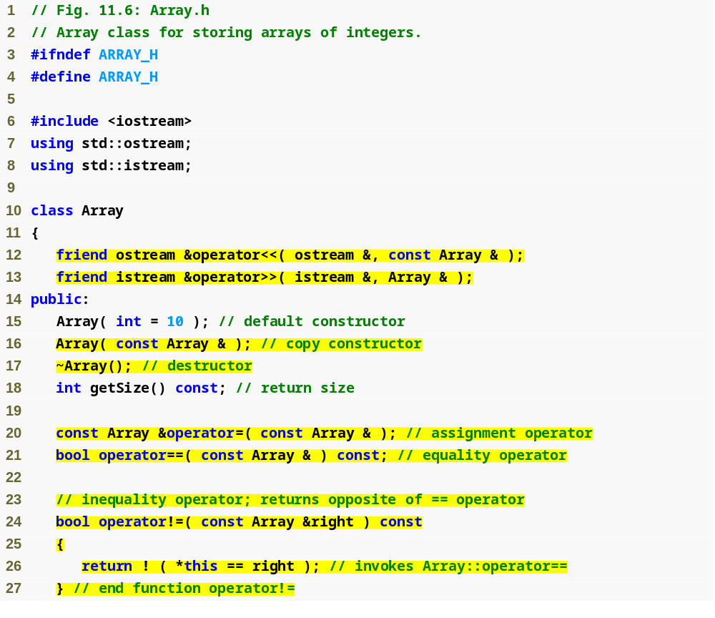
EXAMPLE #2
Array.h
(1 of 2)
Most operators overloaded as member functions (except << and >>, which must be global functions)
Prototype for copy constructor
!= operator simply returns opposite of == operator – only need to define the == operator

Slide 29
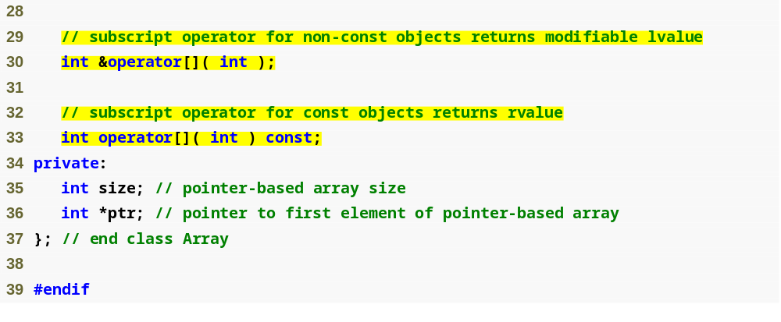
Operators for accessing specific elements of Array object
EXAMPLE #2
Array.h
(1 of 2)
Question: Why must << and >> be overloaded as global functions?
Why are they overloaded as friend functions?

Slide 30
Array Example - comments
Default Constructor
  Invoked whenever the compiler sees an instantiation of an Array object, if no argument is input the default of 10 is used
    The argument is for array size
  If an invalid argument is passed into the default construction, the size is set to 10
  Uses new to obtain the memory needed for an array of the size passed into the constructor or the default size of 10
    Must use new to dynamically allocate memory
  Uses the for loop to set all elements of the pointer based array created with new to zero
    This is good programming practice to set a default value for each array element

Slide 31
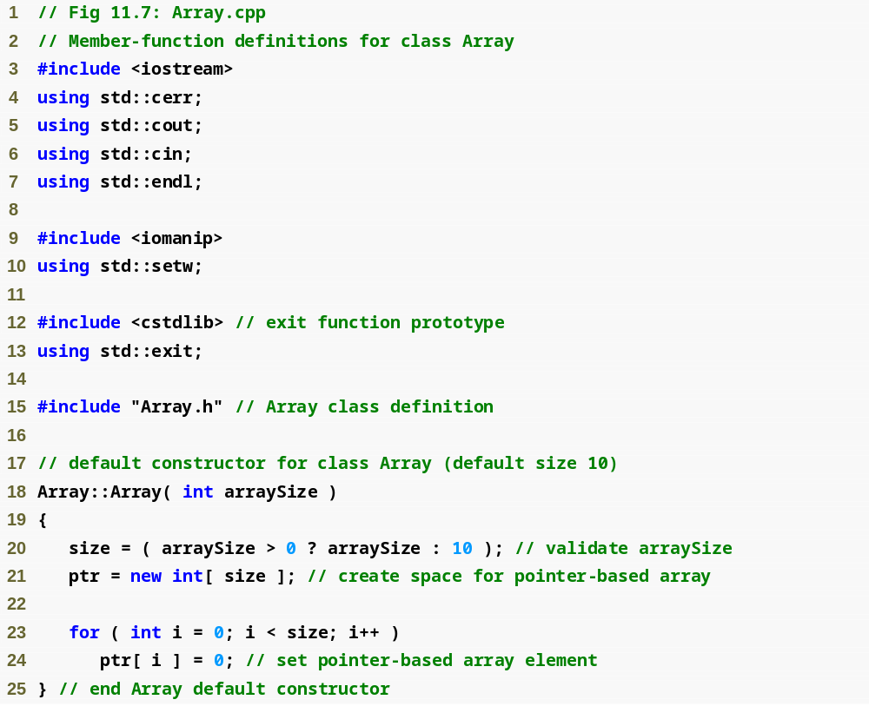
EXAMPLE #2
Array.cpp
(1 of 6)

Slide 32
Array Example - comments
The Copy Constructor
  Remember this is a special constructor that intializes an object by making a copy of an existing object
    When dealing with pointers we don't want the memberwise assignment behavior the default copy constructor performs so we must define our own copy constructor
      Question: Why is this?
        To avoid leaving both Array objects pointing to the SAME dynamically allocated memory which is what would happen with memberwise assignment
IMPORTANT: Copy constructors are invoked whenever a copy of an object is needed including:
    passing an object by value to a function
    returning an object by value from a function
    initializing an object with a copy of another object of the same class (the main one we've discussed)
Note that a copy constructor must receive its argument by reference, not by value.
  Otherwise, the copy constructor call results in infinite recursion (a fatal logic error) because receiving an object by value requires the copy constructor to make a copy of the argument object.
  Recall that any time a copy of an object is required, the class’s copy constructor is called.
  If the copy constructor received its argument by value, the copy constructor would call itself recursively to make a copy of its argument!
The argument to a copy constructor should be a const reference to allow a const object to be copied.

Slide 33
Array Example - comments
Copy constructor (summary)
  Used whenever copy of object is needed:
    Passing by/Returning by value (return value or parameter)
    Initializing an object with a copy of another of same type
      Array newArray( oldArray ); or
      Array newArray = oldArray; (both are identical)
        newArray is a copy of oldArray
  Prototype for copy constructor in class Array
    Array( const Array & );
    Must take reference
      Otherwise, the argument will be passed by value…
        Which tries to make copy by calling copy constructor…Infinite loop

Slide 34
Array Example - comments
The Destructor
  Invoked when an object of class Array goes out of scope
  Uses delete to dynamically release memory created by new in the constructor

Slide 35
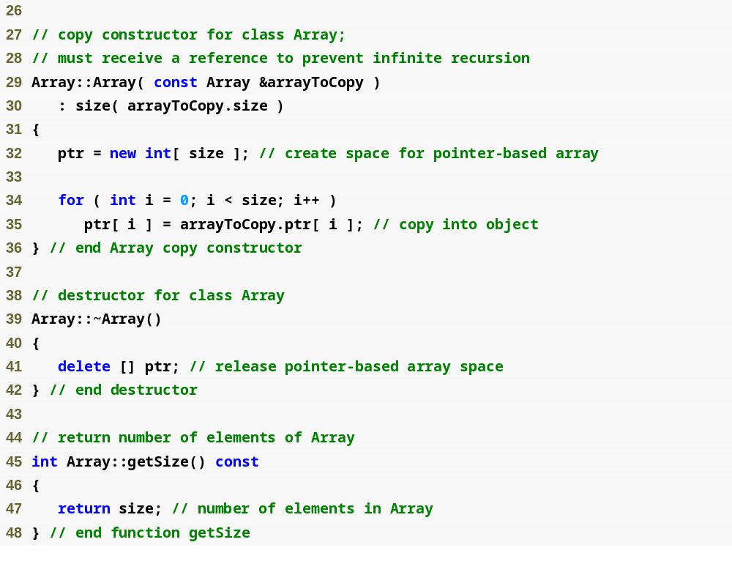
EXAMPLE #2
Array.cpp
(2 of 6)
We must declare a new integer array so the objects do not point to the same memory

Slide 36
Array Example - comments
Overloaded Assignment Operator
  When the compiler sees an expression like this for two Array objects integers1 and integers2:
    integers1 = integers2;
    It invokes the function operator = with the call: integers1.operator=(integers2);
    This function is setting the argument on the left equal to the argument on the right
If we don't overload this we're stuck with memberwise assignment with doesn't work when we have pointers as member variables

Slide 37
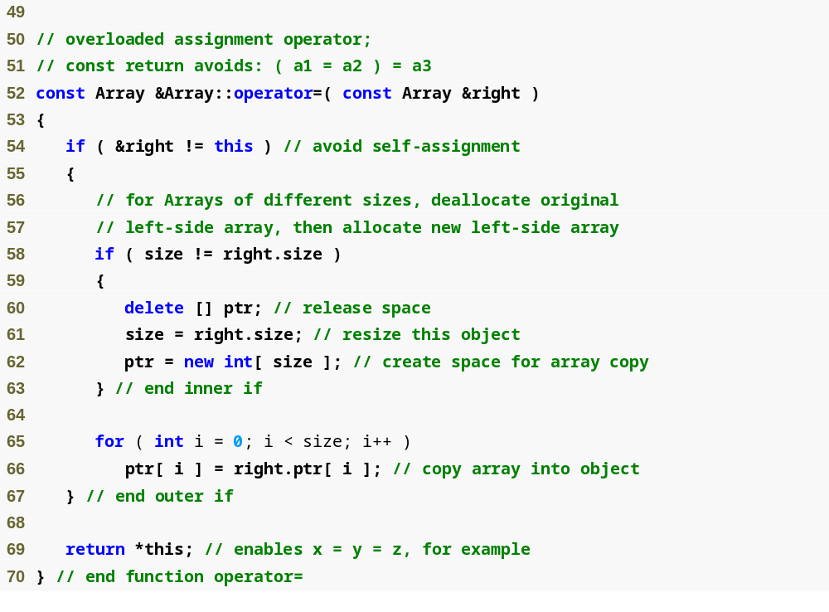
Want to avoid self assignment
This would be dangerous if this is the same Array as right
because you could leave ptr pointing to memory that has been deallocated
EXAMPLE #2
    This function is setting the argument on the left equal to the argument on the right, copy the right
    Array object into the left
Array.cpp
(3 of 6)

Slide 38
Array Example - comments
Overloaded Equality (==) Operator
  When the compiler sees an expression like this for two Array objects integers1 and integers2:
    integers1 == integers2;
    It invokes the function operator = with the call: integers1.operator==(integers2);
    returns true if the two Array objects are equal (by equal we mean the same size with the same element in each corresponding array position)
Overloaded subscript operator
  We have two of these one for const arrays and one for non const arrays
    Remember a program can only invoke const member functions for a const object

Slide 39
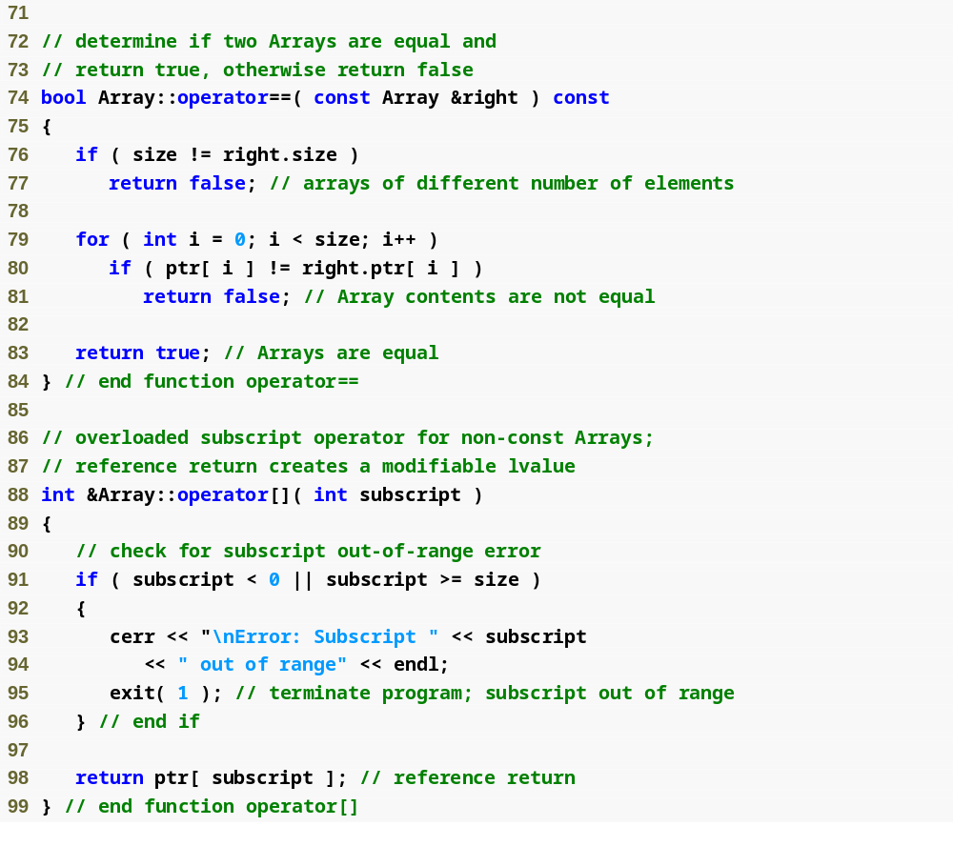
EXAMPLE #2
Array.cpp
(4 of 6)
integers1[ 5 ] calls integers1.operator[]( 5 )

Slide 40
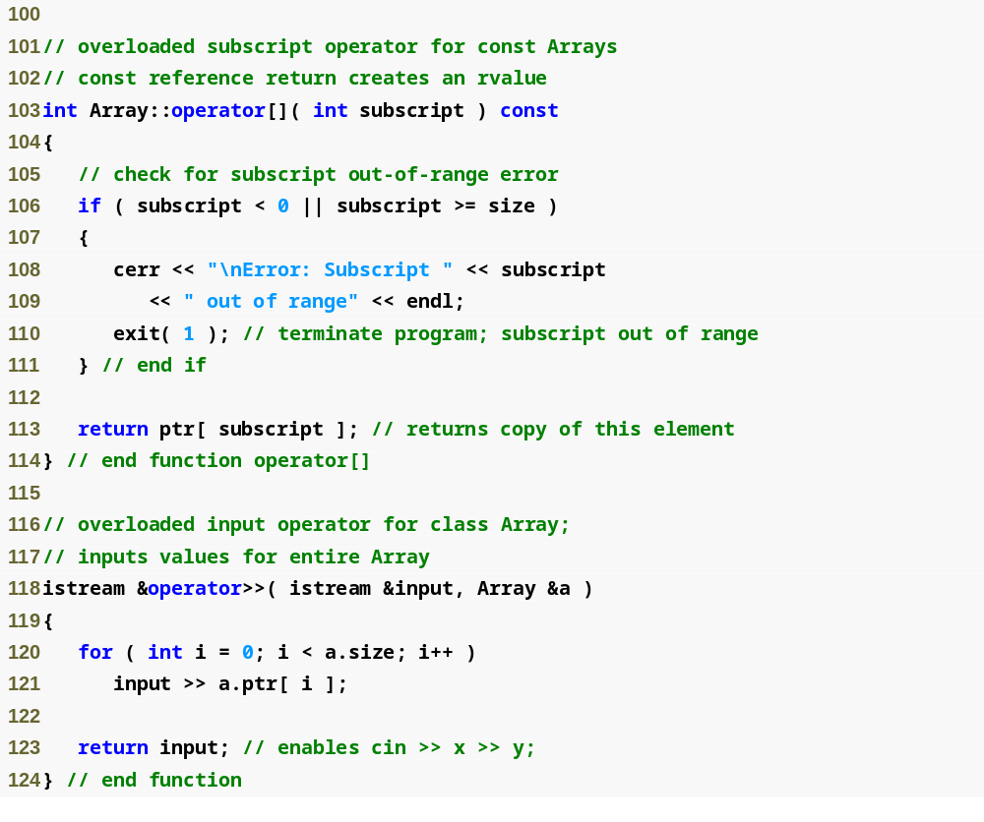
EXAMPLE #2
Array.cpp
(5 of 6)

Slide 41
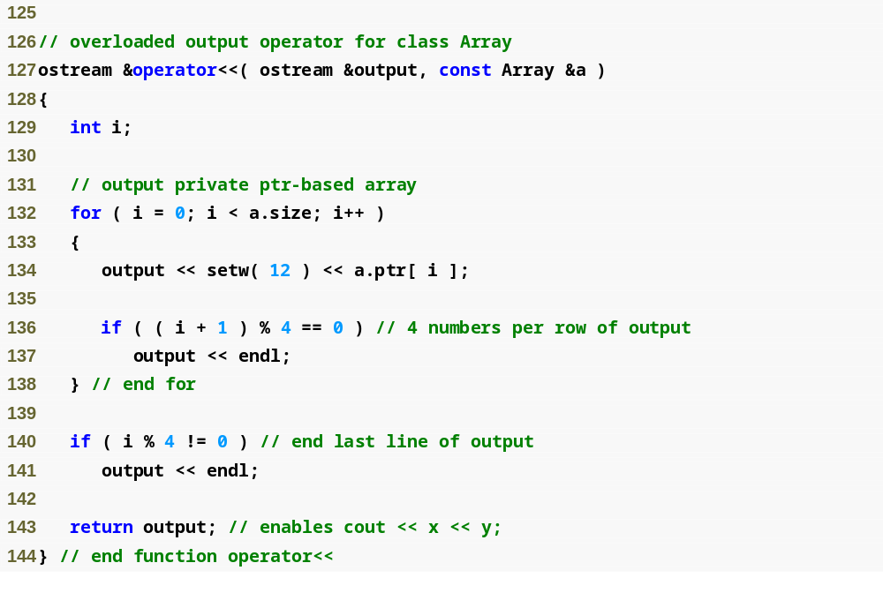
EXAMPLE #2
Array.cpp
(6 of 6)

Slide 42
Array Class Client test Program
Example 2:
  testArray.cpp (page 1 of 4)
  I changed this from the book slightly so this is my code with comments above explaining
#include <iostream>
#include <stdlib.h>
using namespace std;
#include "Array.h"
int main()
{
Array integers1(7); //instantiate a seven element array
Array integers2; //a ten element default array
cout << "ARRAY: integers1" << endl;
cout <<"--------------------" << endl;
cout << "Size of Array integers1 is: " << integers1.getSize() << endl;
//uses overloaded <<
cout << "Array integers1 after initialization: " << integers1 << endl;
cout << "\nARRAY: integers2" << endl;
cout <<"--------------------" << endl;
cout << "Size of Array integers2 is: " << integers2.getSize() << endl;
//uses overloaded <<
cout << "Array integers2 after initialization: " << integers2 << endl;
//get array input using overloaded >>
cout << "Enter " << integers1.getSize() << " integers with one space in between"
<< "\nto put in Array integers1: ";
cin >> integers1;
//get array input using overloaded >>
cout << "\nEnter " << integers2.getSize() << " integers with one space in between"
<< "\nto put in Array integers2: ";
cin >> integers2;

Slide 43
Array Class Client test Program
Example 2:
  testArray.cpp (page 2 of 4)
  I changed this from the book slightly so this is my code with comments above explaining
cout << "\nARRAY: integers1" << endl;
cout <<"--------------------" << endl;
cout << "Array integers1 after input: " << integers1 << endl;
cout << "\nARRAY: integers2" << endl;
cout <<"--------------------" << endl;
cout << "Array integers2 after input: " << integers2 << endl;
//use overloaded inequality operator (remember this is an inline function, not implicit, explicitly defined)
if(integers1 != integers2)
{
cout << "\nintegers1 and integers2 are NOT equal" << endl;
}
else
{
cout << "\nintegers1 and integers2 ARE equal" << endl;
}
//create Array integers3 using integers1 as an initializer, so we are using
//the copy constructor
Array integers3(integers1);//evokes the special constructor, the copy constructor
cout << "\nARRAY: integers3" << endl;
cout <<"--------------------" << endl;
cout << "Size of Array integers3 is: " << integers3.getSize() << endl;
//uses overloaded <<
cout << "Array integers3 after initialization with copy constructor: " << integers3 << endl;

Slide 44
Array Class Client test Program
Example 2:
  testArray.cpp (page 3 of 4)
  I changed this from the book slightly so this is my code with comments above explaining
//use the overloaded = operator to assign integers2 to integers1
//afterwards they are the same
integers1 = integers2;
cout << "\nARRAY: integers1" << endl;
cout <<"--------------------" << endl;
cout << "Array integers1 after assignment operator executed: " << integers1 << endl;
cout << "\nARRAY: integers2" << endl;
cout <<"--------------------" << endl;
cout << "Array integers2 after assignment operator executed: " << integers2 << endl;
//use overloaded equality operator
if(integers1 == integers2)
{
cout << "\nintegers1 and integers2 ARE equal" << endl;
}
else
{
cout << "\nintegers1 and integers2 are NOT equal" << endl;
}
//using overloaded subscript operator
integers1[5] = 1000;
cout << "\nAfter the assignment, integers1[5] is: " << integers1[5] << endl;
cout << "\nARRAY: integers1" << endl;
cout <<"--------------------" << endl;
cout << "Array integers1 after changing integeres1[5]: " << integers1 << endl;

Slide 45
Array Class Client test Program
Example 2:
  testArray.cpp (page 4 of 4)
  I changed this from the book slightly so this is my code with comments above explaining
//uncomment the part below to see what happens if invalid subscripts are //attempted to be changed
//there should be a better design for this, I used the book design
//attempt to change invalid subscript integers[15]
/*integers1[15] = 1000;
cout << "\nAfter the assignment, integers1[15] is: " << integers1[15] << endl;
cout << "\nARRAY: integers1" << endl;
cout <<"--------------------" << endl;
cout << "Array integers1 after attempting to change integeres1[15]: " << integers1 << endl;*/
system("PAUSE");
return 0;
};

Slide 46
Software Engineering Observation
A copy constructor, a destructor and an overloaded assignment operator should ALWAYS be provided as a group for any class that uses dynamically allocated memory.

Slide 47
Common Programming Error 11.8
Not providing an overloaded assignment operator and a copy constructor for a class when objects of that class contain pointers to dynamically allocated memory is a logic error.

Slide 48
Software Engineering Observation 11.6
It is possible to prevent one object of a class from being assigned to another. This is done by declaring the assignment operator as a private member of the class.

Slide 49
Software Engineering Observation 11.7
It is possible to prevent class objects from being copied; to do this, simply make both the overloaded assignment operator and the copy constructor of that class private.

